Slide 1

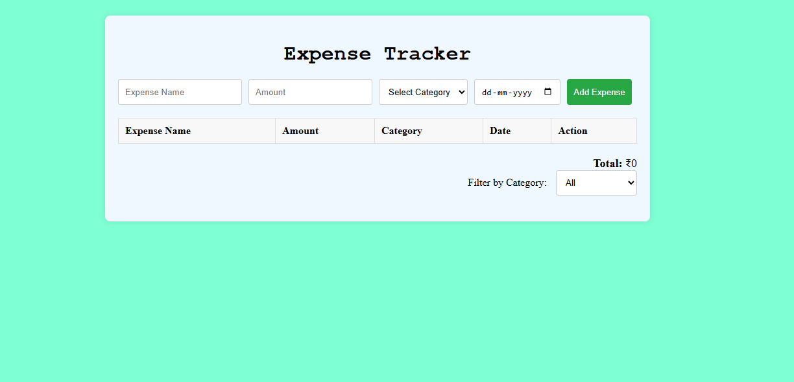
Expense Tracker Web Application
This report outlines the development of an Expense Tracker web
application using HTML, CSS, and JavaScript to manage finances by
inputting expenses/income, categorizing transactions, and viewing a
financial summary.

Slide 2
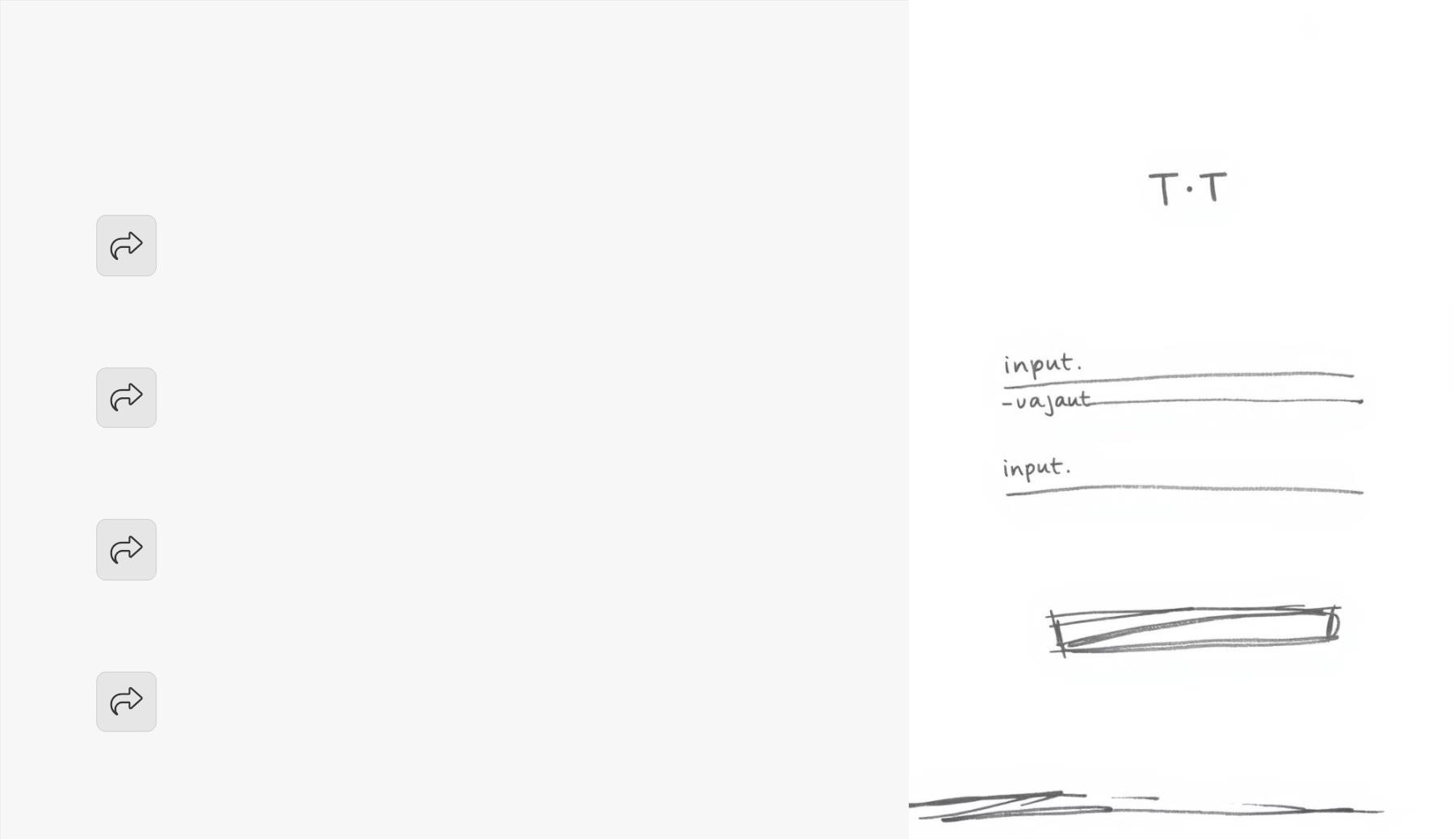
Implemented Features
Input Form
Add transactions with details: Description, Amount, Category.
Transaction List
Displays recorded transactions in a table format.
Balance Summary
Shows total balance, income, and expenses.
Filtering/Searching
Filter transactions by category or type.

Slide 3

Core Functionality (JavaScript)
Adding Transactions
Deleting Transactions
Calculating Totals
Data Persistence
Validates input fields;
updates transaction list
dynamically.
Removes transactions,
updates balance.
Automatically
calculates/displays total
income, expenses, balance.
Transactions stored in
localStorage for
persistence.

Slide 4
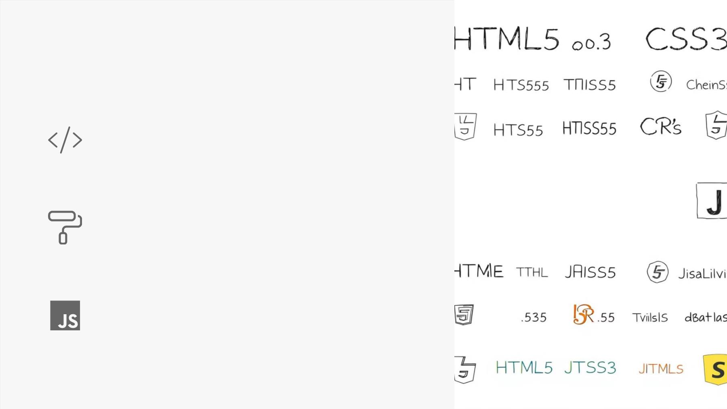
Technologies Used
HTML5
Structure
CSS3
Styling, Responsive Design
JavaScript
Dynamic Functionality

Slide 5
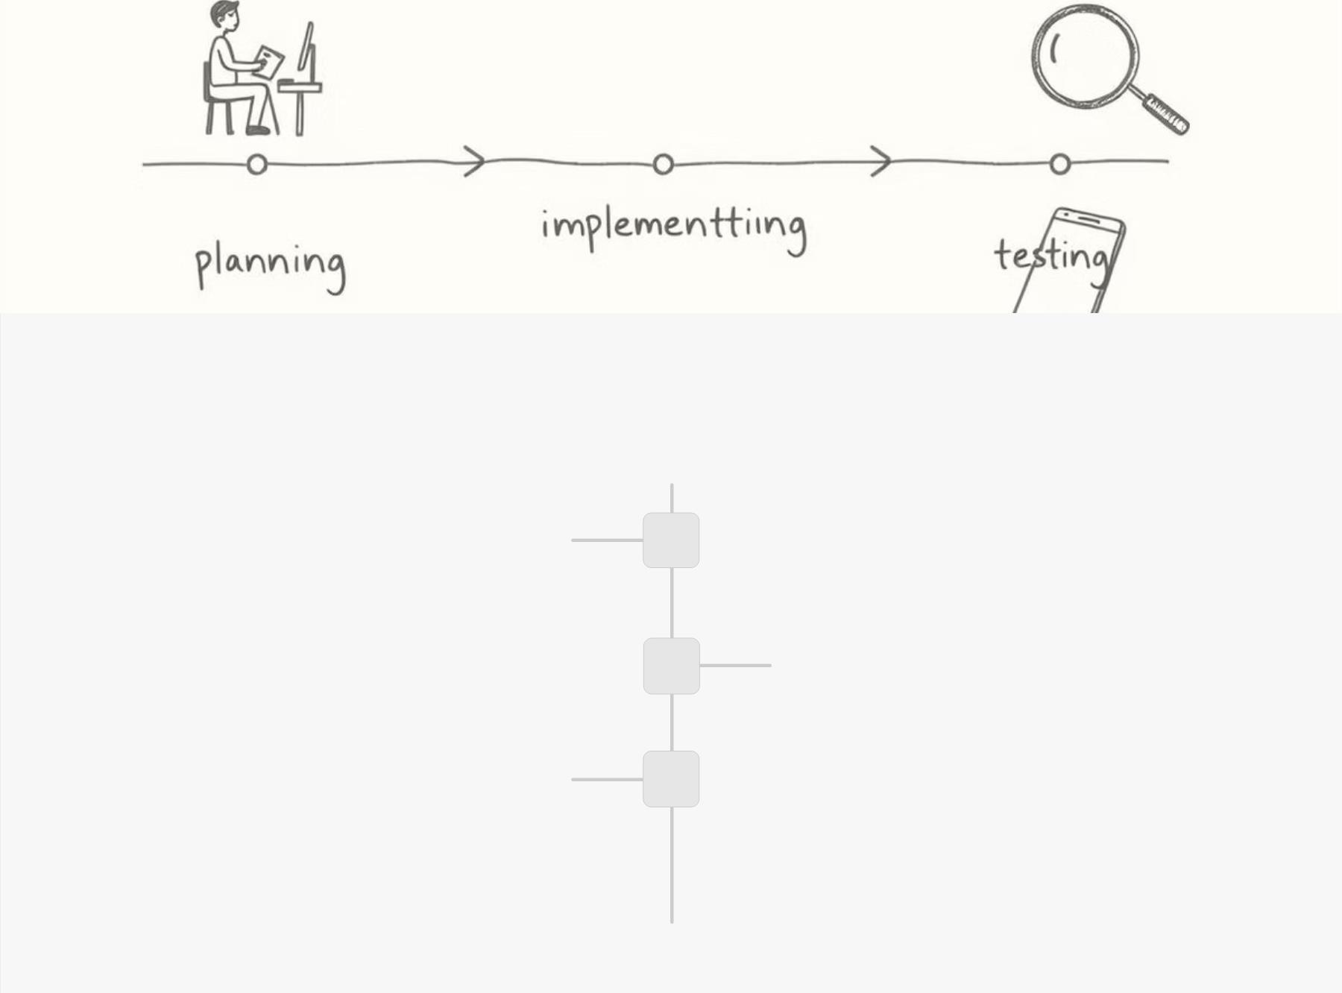
Development Process
Planning
1
Defined core features, designed UI, decided on data
structure.
2
3
Implementation
HTML structure, CSS styling, JavaScript logic.
Testing
Adding/deleting transactions, checking balance
updates, persistence.

Slide 6

Challenges Faced & Solutions
Dynamic DOM Updates
1
2
3
Used JavaScript to manipulate the DOM efficiently.
Data Validation
Added form validation checks before processing.
LocalStorage Implementation
Used JSON.stringify() and JSON.parse() for storage.

Slide 7
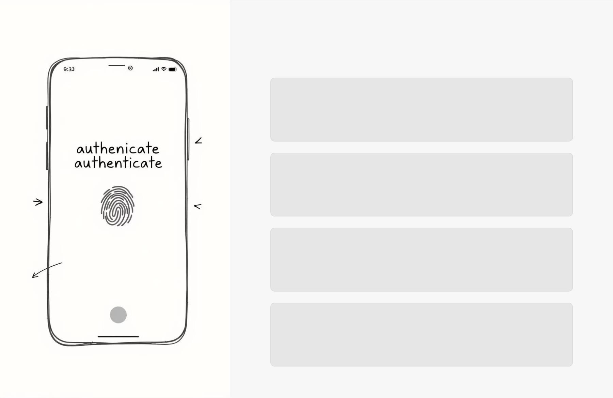
Future Improvements
Charts & Visualizations
Integrate Chart.js for expense/income trends.
User Authentication
Allow multiple users to track expenses.
Export Data
Download transactions as CSV/PDF.
Mobile App Version
Convert to a Progressive Web App (PWA).

Slide 8

Conclusion & Takeaways
The Expense Tracker web application meets assignment
requirements.
The project enhanced understanding of DOM manipulation and data
persistence.
Future enhancements can make it more robust and user-friendly.

